Slide 1
Reinforcement Learning
Swati Jain

Slide 2
Learning Paradigm
Supervised learning —Feeding labeled data into a neural network. Essentially, telling the machine what it’s outcome.
Unsupervised learning —Not providing labeled data. no specified goal or target; the machine uncovers structural aspects of the data as it learns.
Reinforcement learning – providing partial information to the model, but not providing a correct answer or action. Reinforcement learning is a form of semi supervised learning.

Slide 3
Reinforcement Learning
Notes:
REINFORCEMENT LEARNING
The theory of reinforcement learning is inspired by the psychological and neuroscientific perspectives of human behavior [11], concerned with the problem of selecting an appropriate action from a set of actions in an environment, to maximize some cumulative reward. Reinforcement Learning are not given explicit path, instead it uses trial and error to reach the goal initially, but later uses its past experience to take the optimal path, in the problem an agent decides the best action only on the basis of its current state, this is best described by Markov Decision Process. Fig. 3. shows the pictorial representation of Reinforcement Learning, where the reinforcement Learning model consists of following things:
•A set of environment and agent states S.
•A set of actions A of the agent.
•Policies of transitioning from states to actions.
•Rules that determine the scalar immediate reward of a transition
Rules that describe what the agent observes.

Slide 4
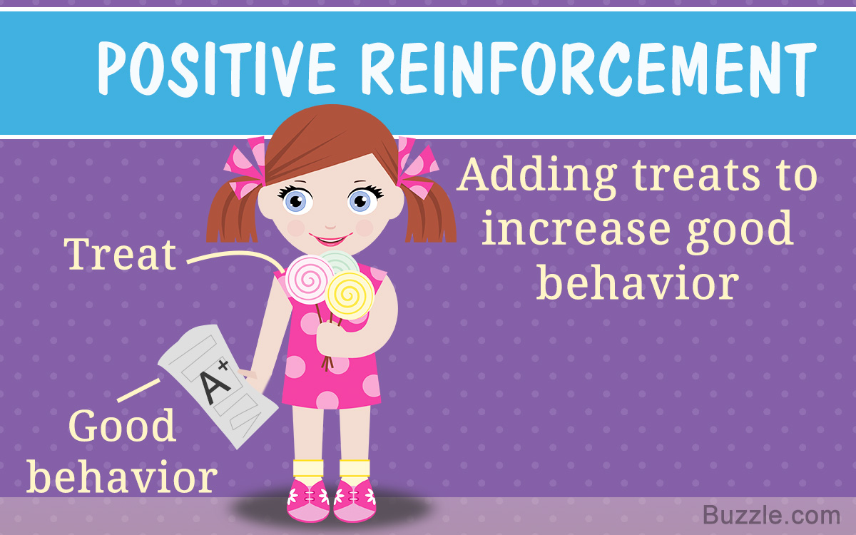
Analogy to Human Learning

Slide 5
Reinforcement Learning Environment

Slide 6
Markov Decision Principal

Slide 7
Agents Learning Task

Slide 8
Value Function

Slide 9
Q- Function

Slide 10
Training Rule of Q

Slide 11
Q Learning for Deterministic world

Slide 12
An Example

Slide 13
Why Reinforcement Learning
No training Data in the form of instance and outcome
Creating such as a data set might be expensive and unfeasible
This approach learns to imitate a human expert
It is possible to proximate the amount of error.
It is Possible to Quantify the rewards and the state space.

Slide 14
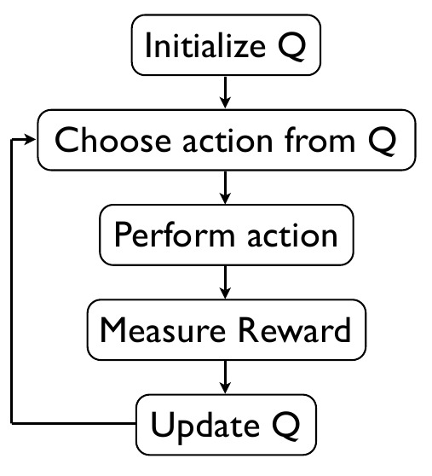
Algorithm

Slide 15
Success Stories of RL
Robotics
(Quadruped Gait Control) Policy Gradient Reinforcement Learning for Fast Quadrupedal Locomotion by Nate Kohl and Peter Stone
(Quadruped Ball Acquisition) Learning Ball Acquisition on a Physical Robot by Peggy Fidelman and Peter Stone
(Air Hockey) Learning from Observation Using Primitives, and particularly the movie of a humanoid robot playing air hockey. Control
(Helicopter control) Inverted autonomous helicopter flight via reinforcement learning, by Andrew Y. Ng, Adam Coates, Mark Diel, Varun Ganapathi, Jamie Schulte, Ben Tse, Eric Berger and Eric Liang. In International Symposium on Experimental Robotics, 2004.
Operations Research
Games : Game “GO”
HCI

Slide 16
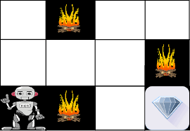
In Computing
The goal of the robot is to get the reward the diamond and avoid the hurdles that is fire.
The robot learns by trying all the possible paths and then choosing the path which gives him the reward with the least hurdles.
Each right step will give the robot a reward and each wrong step will subtract the reward of the robot.
The total reward will be calculated when it reaches the final reward that is the diamond.

Slide 17

Learning Outcome
0 | -100 | 0 | 0
0 | 0 | 0 | -100
0 | -100 | 0 | +100
-80 | -100 | 60 | 40
50 | 70 | 80 | -100
0 | -100 | 90 | +100

Slide 18
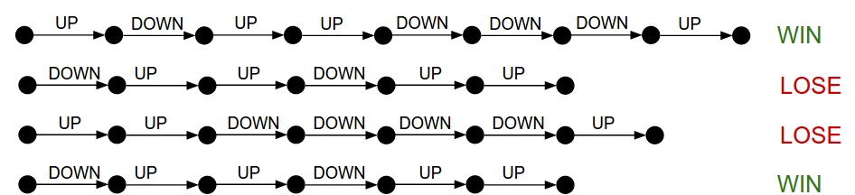
Episode/Policy

Slide 19
Our Problem
We do not have training examples.
Goal is to reach the desired Position
Reward when reaches the goal
Penalise proportionate to the distance from the goal which adds up.
Learn the Q values for states and action
Large Number of States So learning needs Deep Networks.
We allow the robotic arm to explore and create experience

